Slide 1
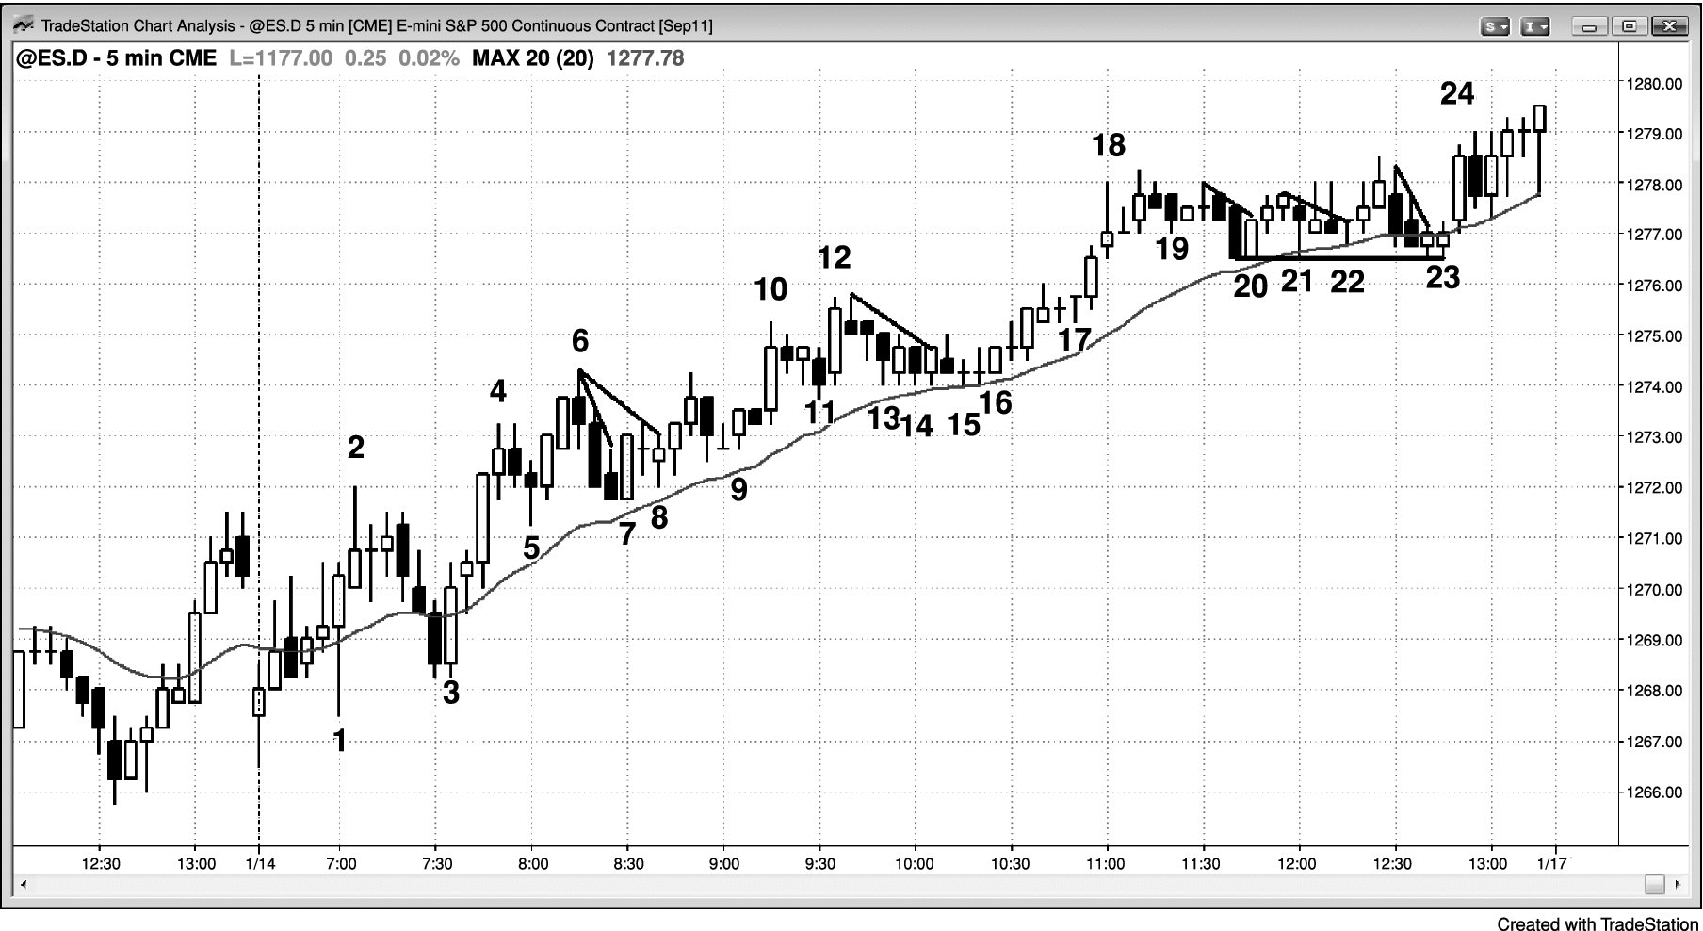
FIGURE 31.1 Scaling In Is Not for Most Traders

Slide 2
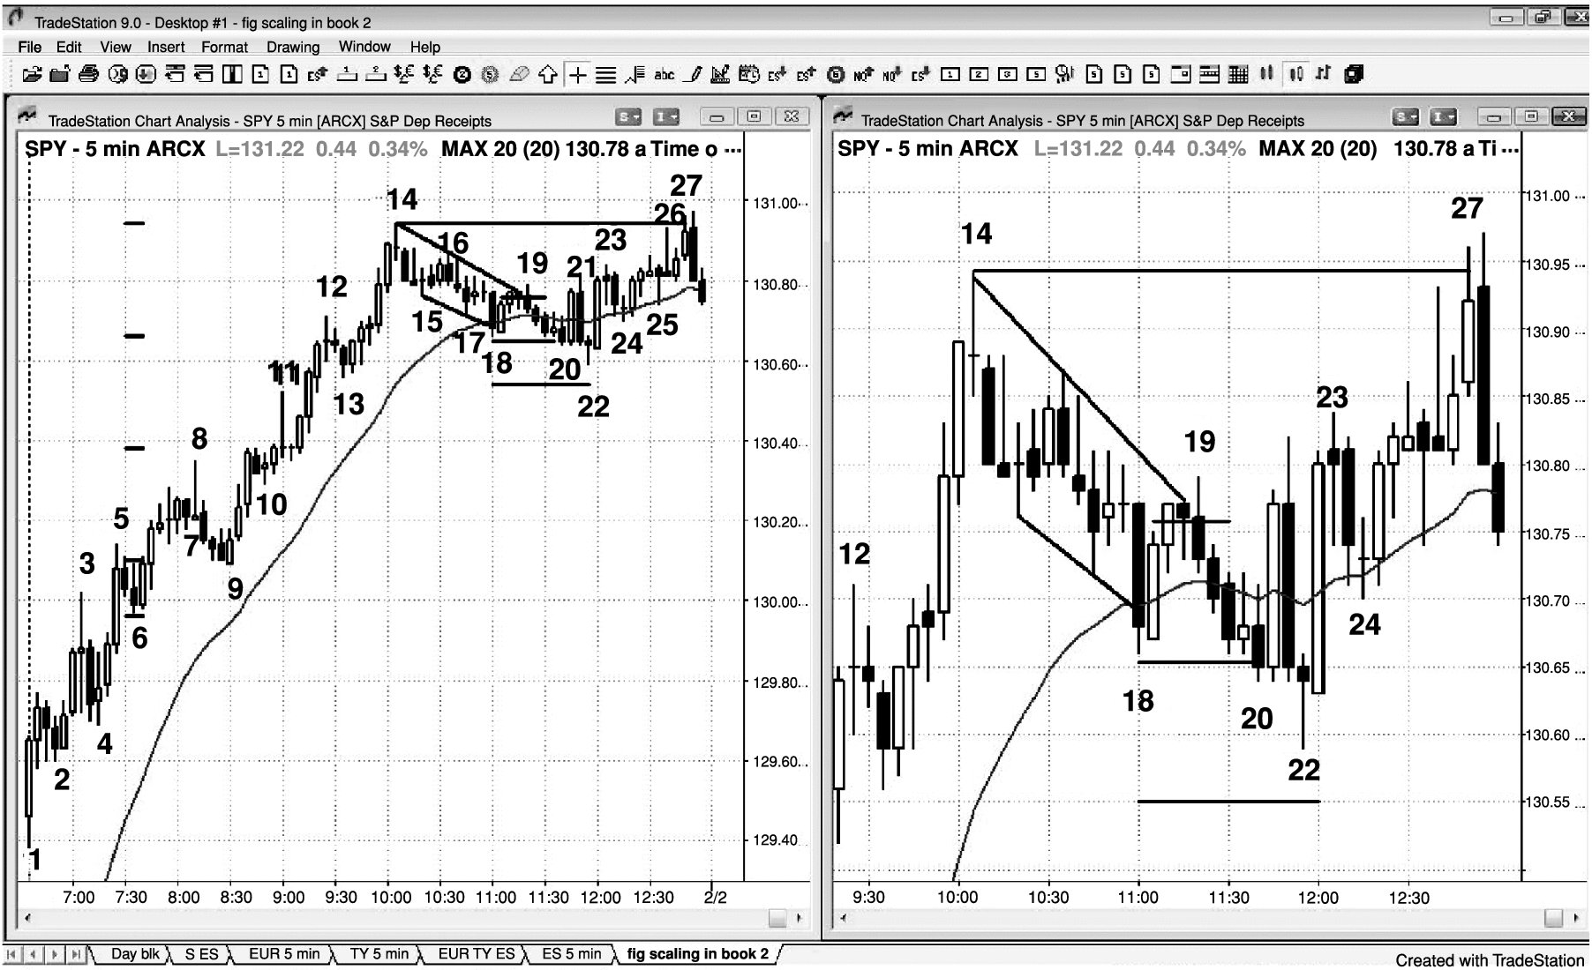
FIGURE 31.2 Scaling into Longs

Slide 3
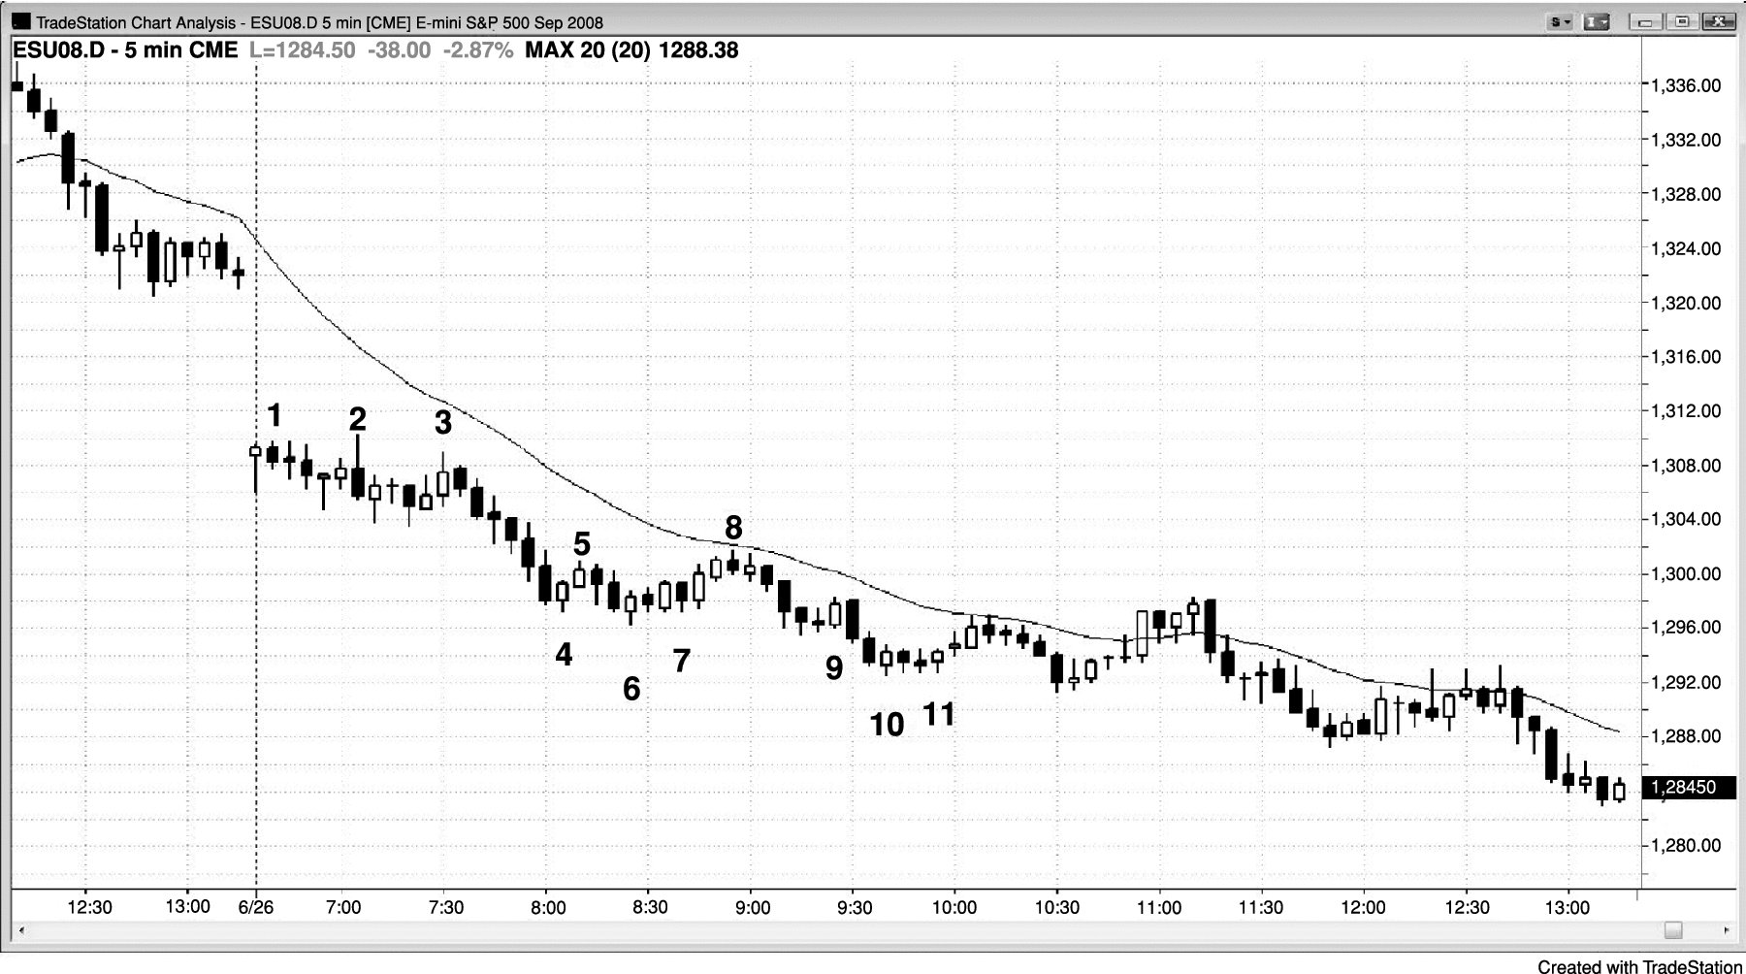
FIGURE 31.3 Institutions Scale In as the Market Goes against Them

Slide 4
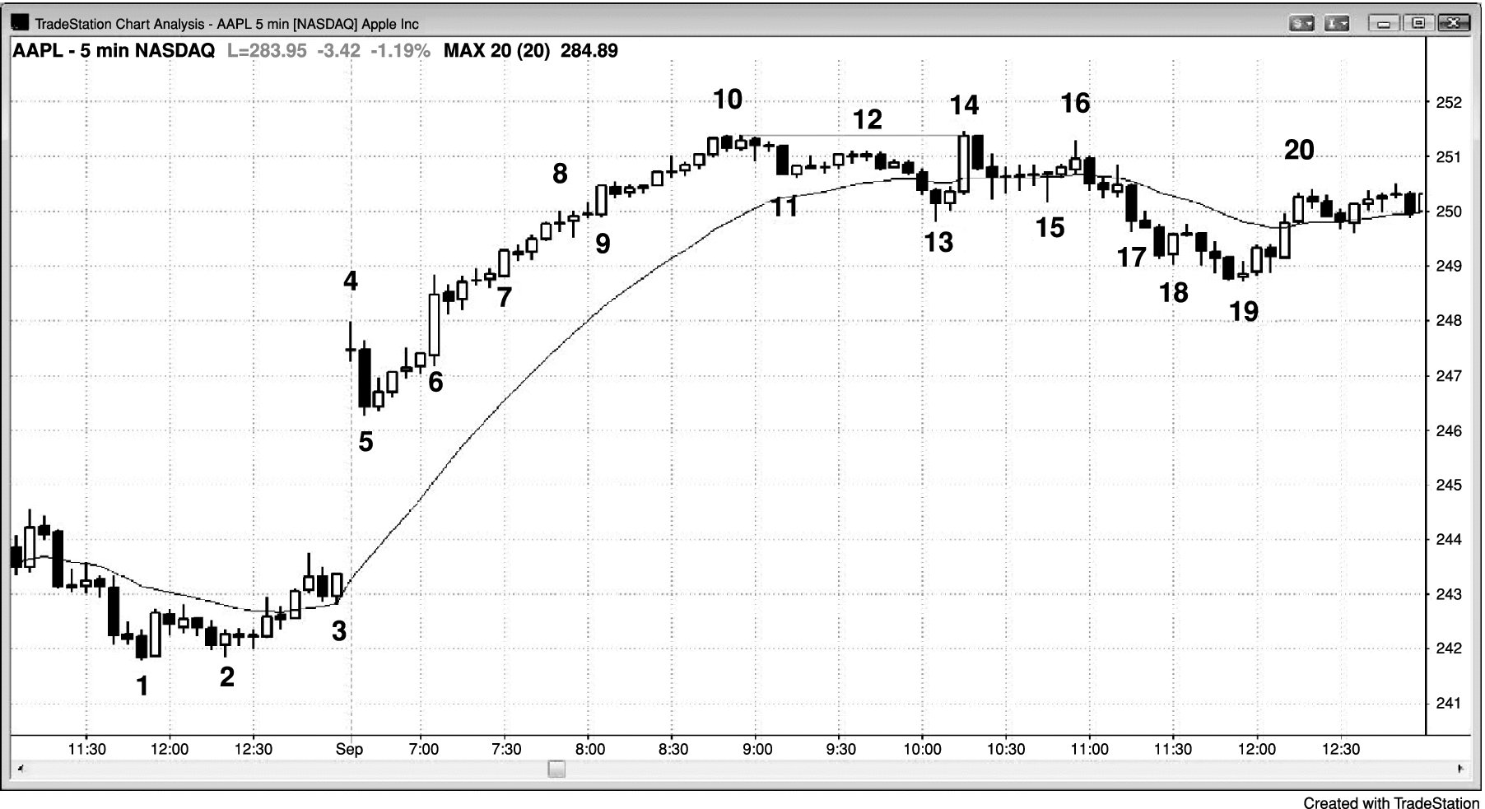
FIGURE 31.4 In Strong Bull Channels, Traders Scale In All the Way Up

Slide 5
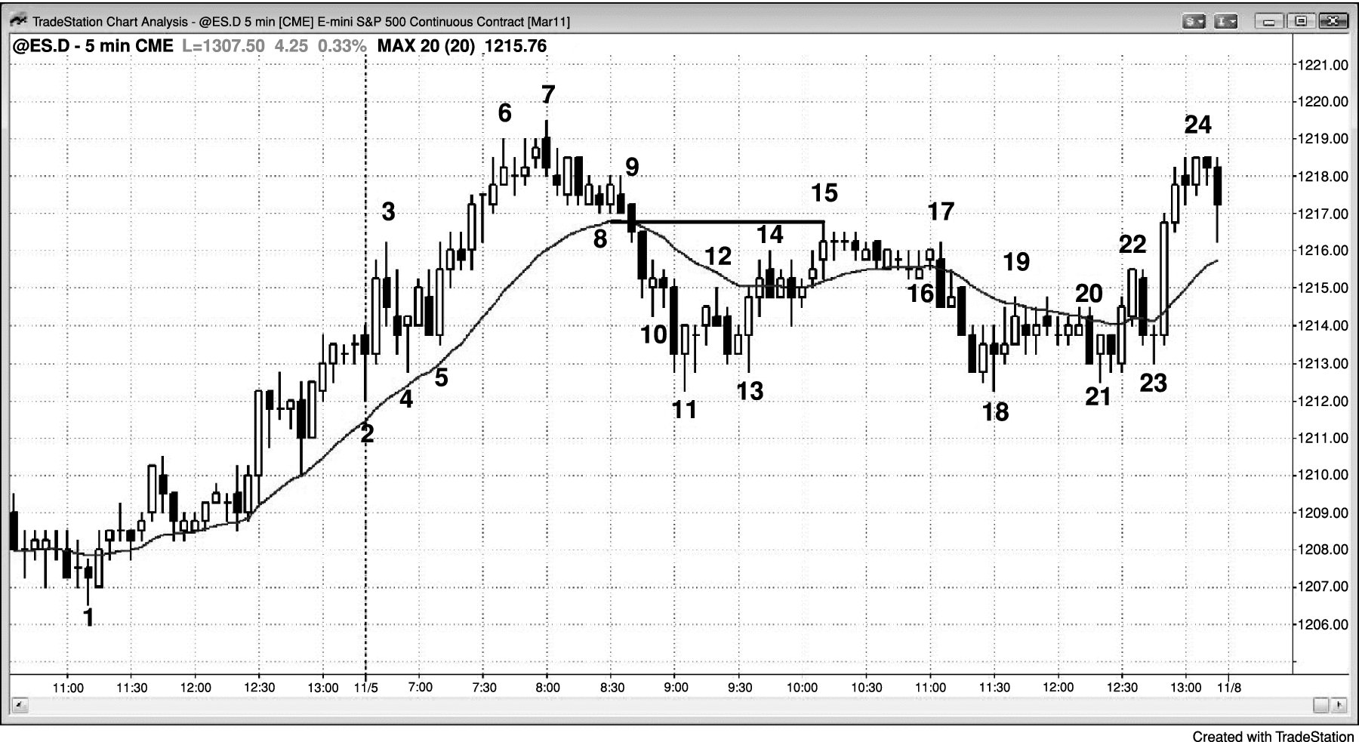
FIGURE 31.5 Scaling into a Pullback

Slide 6
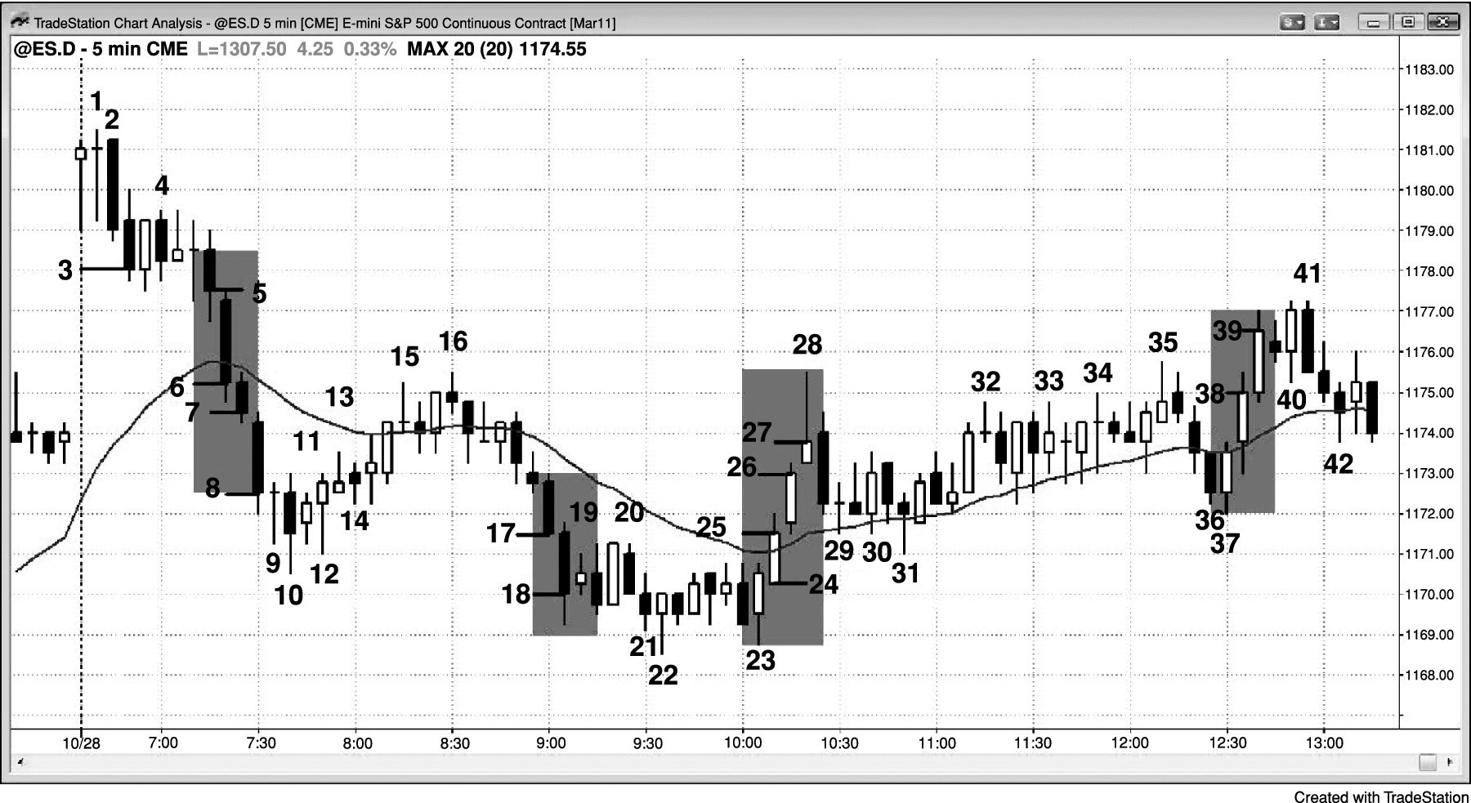
FIGURE 31.6 Scaling In during Spikes

Slide 7
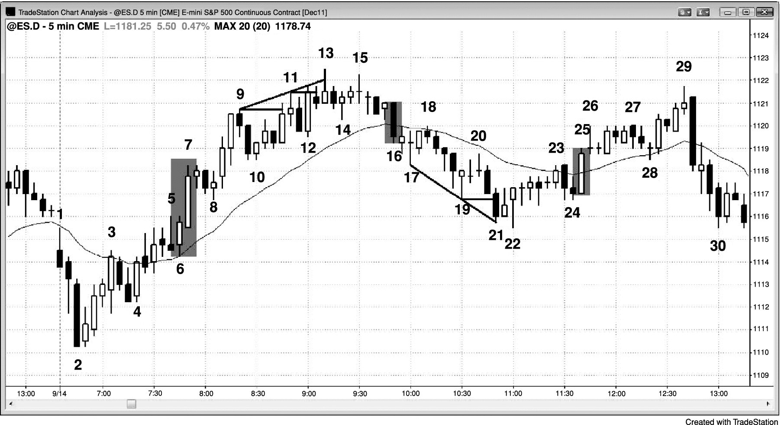
FIGURE 31.7 Scaling In during Channels

Slide 8
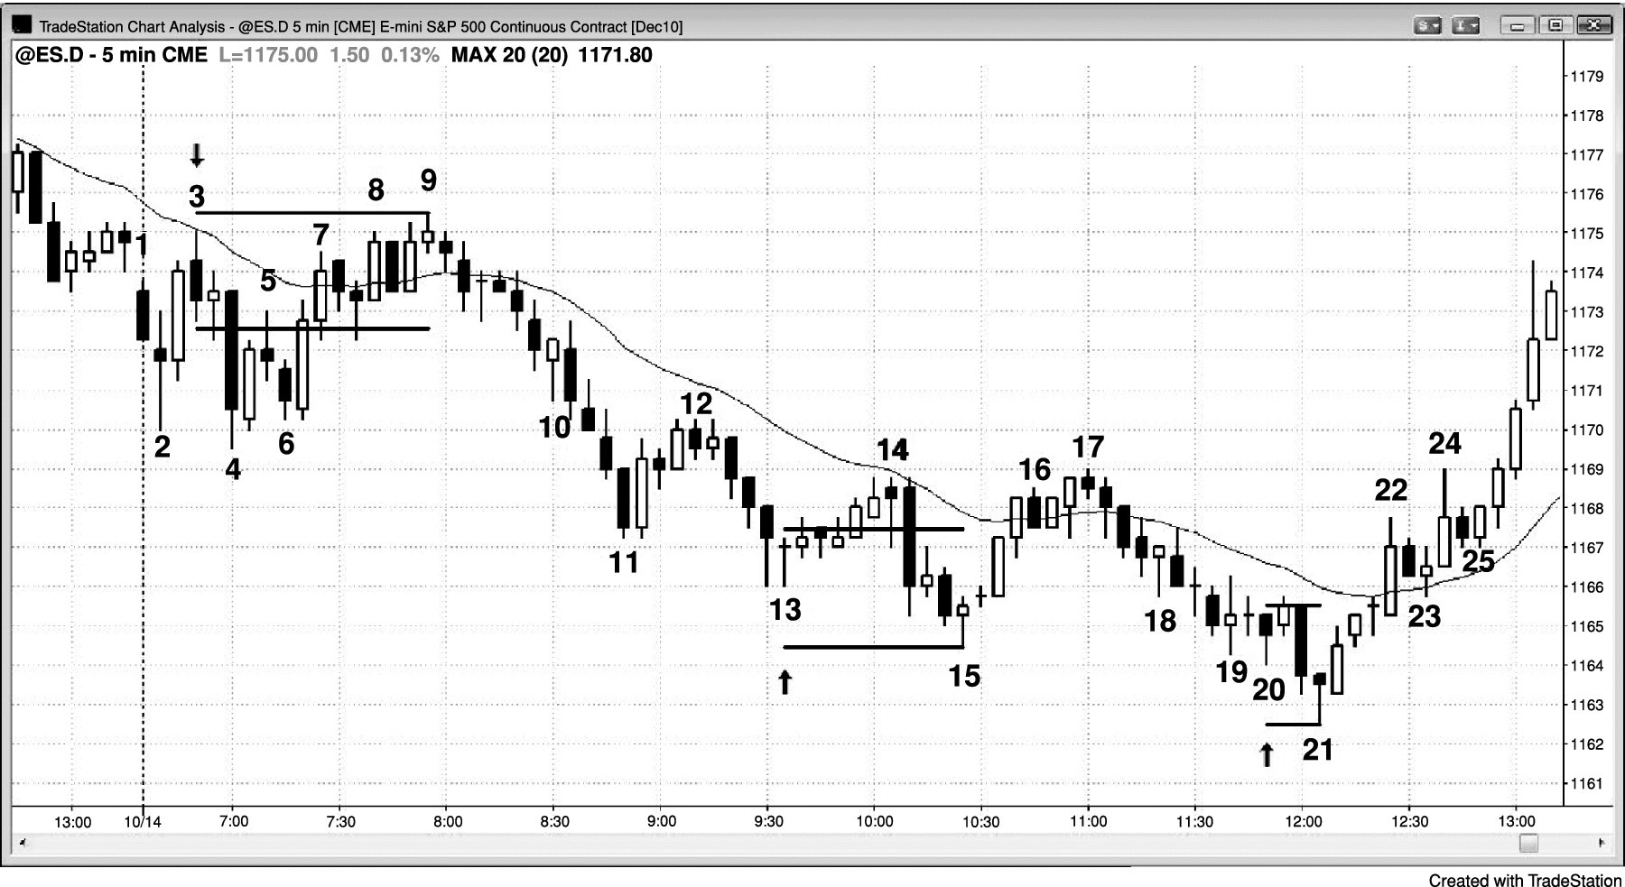
FIGURE 31.8 Entering Where Weak Traders Exit

